Slide 1
6
TECHNIQUES OF INTEGRATION

Slide 2
6.5
Approximate Integration

Slide 3

Approximate Integration
There are two situations in which it is impossible to find the exact value of a definite integral.
The first situation arises from the fact that in order to find using the Evaluation Theorem we need to know an antiderivative of f.
Sometimes, however, it is difficult, or even impossible, to find an antiderivative.
For example, it is impossible to evaluate the following integrals exactly:

Slide 4
Approximate Integration
The second situation arises when the function is determined from a scientific experiment through instrument readings or collected data.
There may be no formula for the function. In both cases we need to find approximate values of definite integrals.

Slide 5

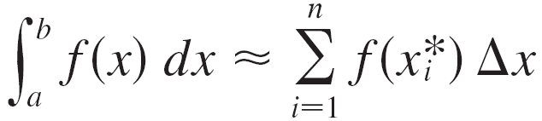



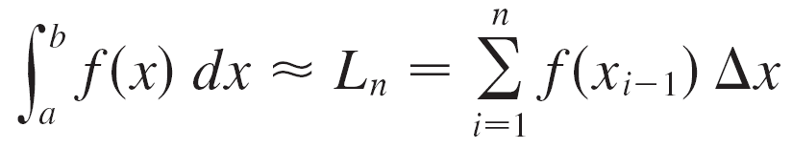

Approximate Integration
We know that the definite integral is defined as a limit of Riemann sums, so any Riemann sum could be used as an approximation to the integral:
If we divide [a, b] into n subintervals of equal length then we have
where is any point in the ith subinterval If is chosen to be the left endpoint of the interval, then and we have

Slide 6


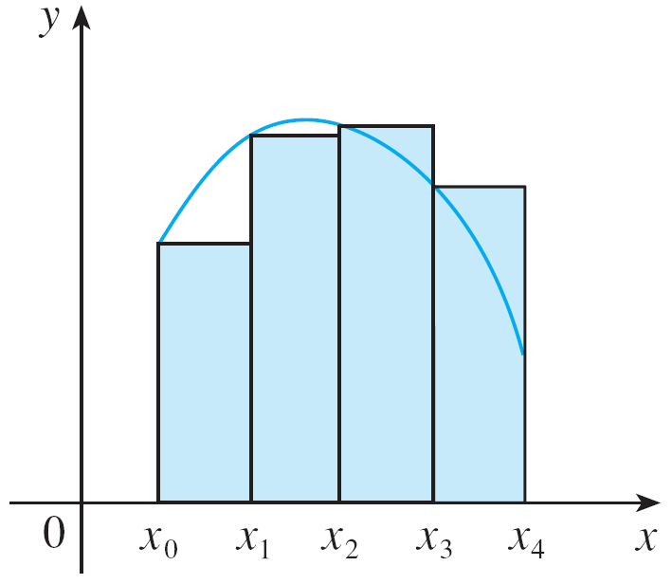
Approximate Integration
If then the integral represents an area and represents an approximation of this area by the rectangles shown in Figure 1(a).
Figure 1(a)

Slide 7

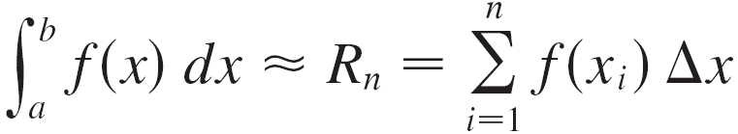

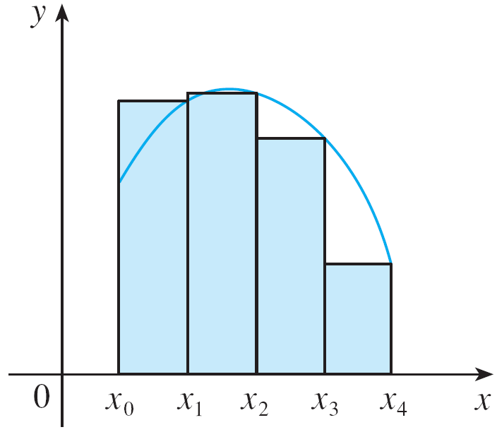
Approximate Integration
If we choose to be the right endpoint, then and we have
[See Figure 1(b).]
(b) Right end point approximation
Figure 1

Slide 8

Approximate Integration
The approximations L_{n} and R_{n} defined by Equations 1 and 2 are called the left endpoint approximation and right endpoint approximation, respectively.
We also considered the case where is chosen to be the midpoint of the subinterval

Slide 9
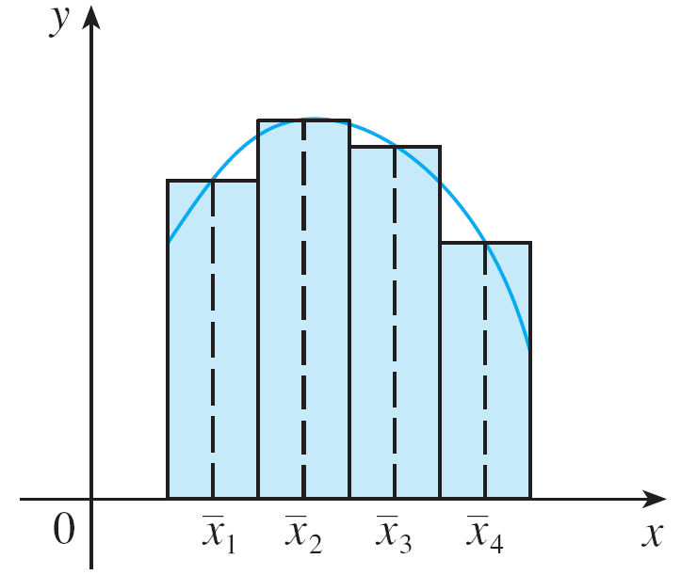
Approximate Integration
Figure 1(c) shows the midpoint approximation M_{n}, which appears to be better than either L_{n} or R_{n}.
(c) Midpoint approximation
Figure 1

Slide 10
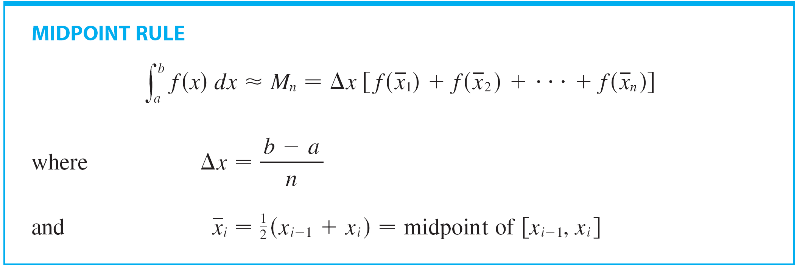
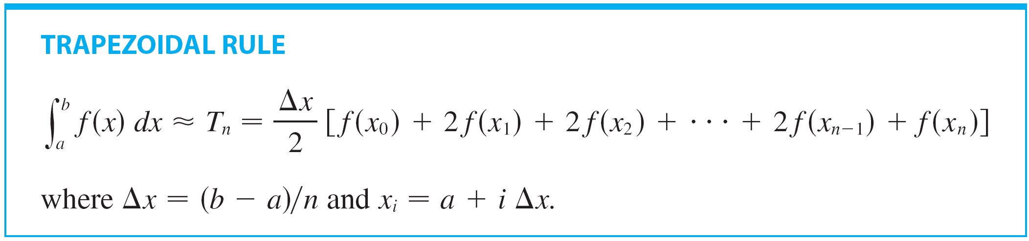
Approximate Integration
Another approximation, called the Trapezoidal Rule, results from averaging the approximations in Equations 1 and 2:

Slide 11
Approximate Integration
The reason for the name can be seen from Figure 2, which illustrates the case f(x) ≥ 0.

Slide 12
TRAPEZOIDAL RULE
The area of the trapezoid that lies above the i th subinterval is:
If we add the areas of all these trapezoids, we get the right side of the Trapezoidal Rule.

Slide 13


Example 1
Use (a) the Trapezoidal Rule and (b) the Midpoint Rule with n = 5 to approximate the integral
SOLUTION:
(a) With n = 5, a = 1, and b = 2, we have and so the Trapezoidal Rule gives

Slide 14
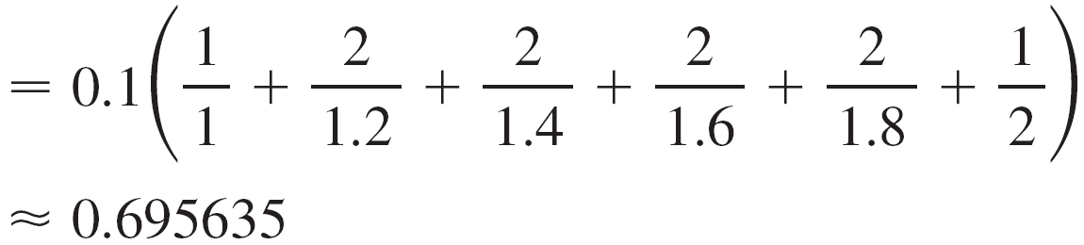
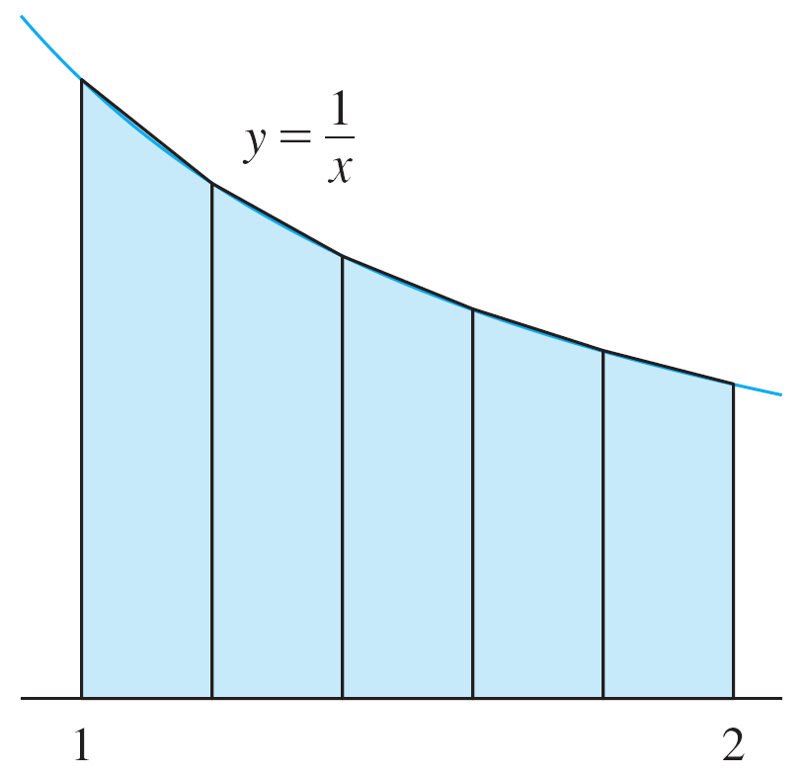
Example 1 – Solution
This approximation is illustrated in Figure 3.
Figure 3

Slide 15
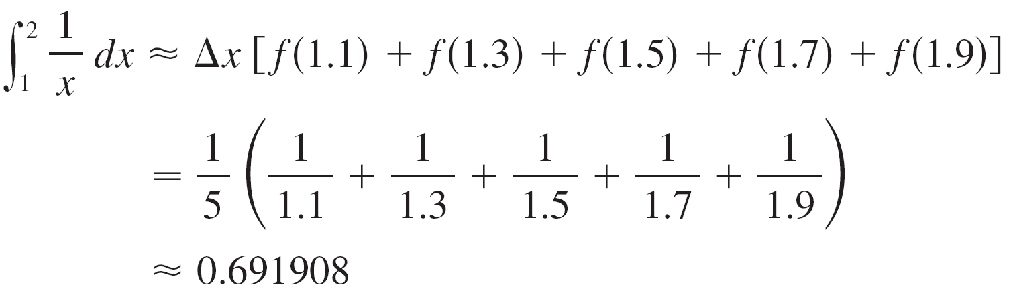
Example 1 – Solution
(b) The midpoints of the five subintervals are 1.1, 1.3, 1.5, 1.7, and 1.9, so the Midpoint Rule gives

Slide 16
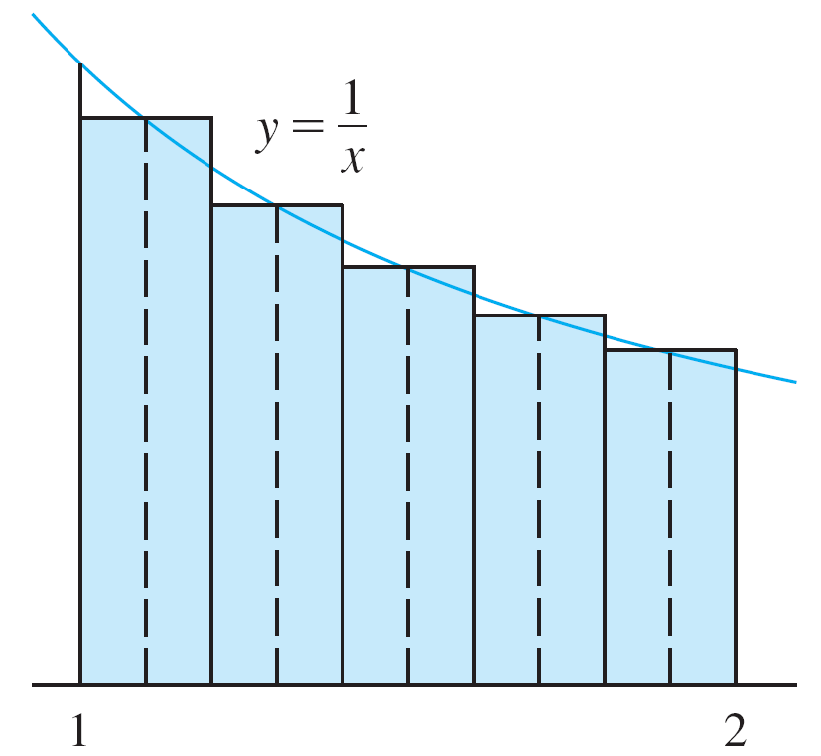
Example 1 – Solution
This approximation is illustrated in Figure 4.
Figure 4

Slide 17
APPROXIMATE INTEGRATION
In Example 1, we deliberately chose an integral whose value can be computed explicitly so that we can see how accurate the Trapezoidal and Midpoint Rules are.
By the FTC,

Slide 18
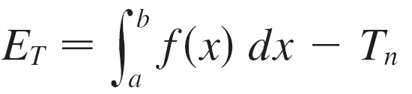
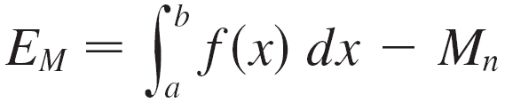
Approximate Integration
The error in using an approximation is defined to be the amount that needs to be added to the approximation to make it exact.
In general, we have
and

Slide 19
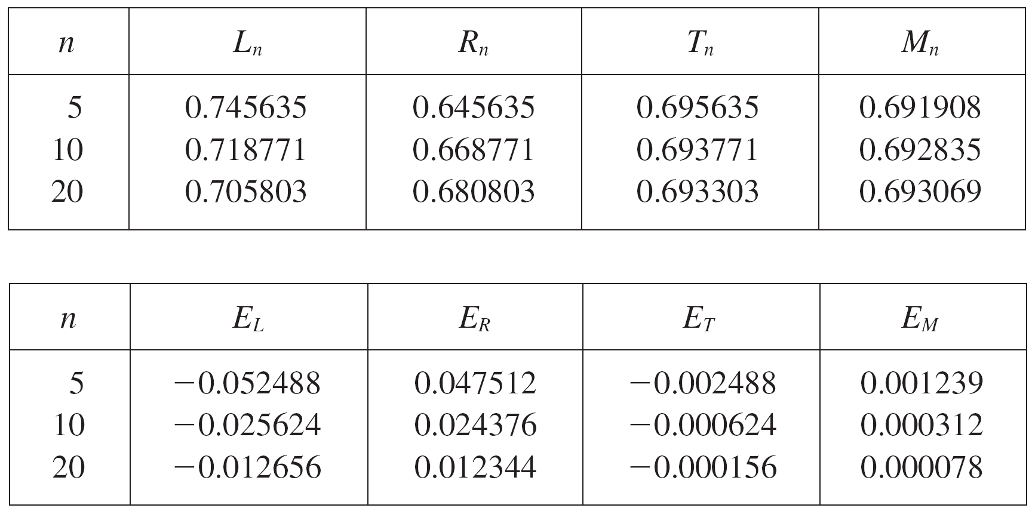
Approximate Integration
The following tables show the results of calculations similar to those in Example 1, but for n = 5, 10, and 20 and for the left and right endpoint approximations as well as the Trapezoidal and Midpoint Rules.

Slide 20
Approximate Integration
We can make several observations from these tables:
1. In all of the methods we get more accurate approximations when we increase the value of n. (But very large values of n result in so many arithmetic operations that we have to beware of accumulated round-off error.)
2. The errors in the left and right endpoint approximations are opposite in sign and appear to decrease by a factor of about 2 when we double the value of n.

Slide 21
Approximate Integration
3. The Trapezoidal and Midpoint Rules are much more accurate than the endpoint approximations.
4. The errors in the Trapezoidal and Midpoint Rules are opposite in sign and appear to decrease by a factor of about 4 when we double the value of n.
5. The size of the error in the Midpoint Rule is about half the size of the error in the Trapezoidal Rule.

Slide 22
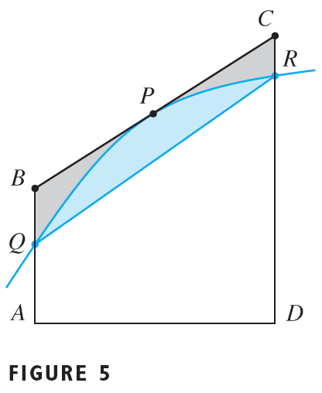
MIDPOINT RULE VS. TRAPEZOIDAL RULE
Figure 5 shows why we can usually expect the Midpoint Rule to be more accurate than the Trapezoidal Rule.

Slide 23
MIDPOINT RULE VS. TRAPEZOIDAL RULE
The area of a typical rectangle in the Midpoint Rule is the same as the area of the trapezoid ABCD whose upper side is tangent to the graph at P.
The area of this trapezoid is closer to the area under the graph than is the area of that used in the Trapezoidal Rule.

Slide 24
MIDPOINT RULE VS. TRAPEZOIDAL RULE
The midpoint error (shaded gray) is smaller than the trapezoidal error (shaded blue).

Slide 25
OBSERVATIONS
These observations are corroborated in the following error estimates—which are proved in books on numerical analysis.
Notice that Observation 4 corresponds to the n² in each denominator because: (2n)² = 4n²

Slide 26
APPROXIMATE INTEGRATION
That the estimates depend on the size of the second derivative is not surprising if you look at Figure 5.
f ’’(x) measures how much the graph is curved.
Recall that f’’(x) measures how fast the slope of y = f(x) changes.

Slide 27
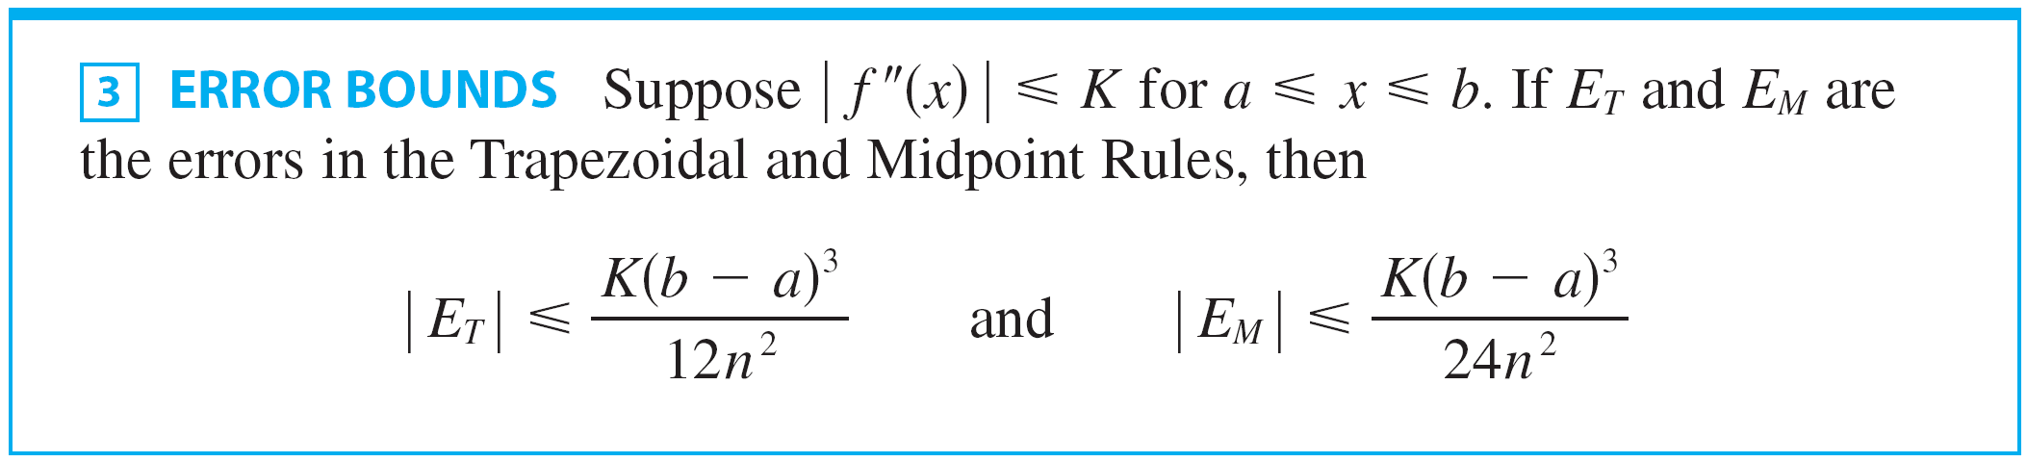
Approximate Integration
Following is the errors estimate for the Trapezoidal and Midpoint Rules:

Slide 28





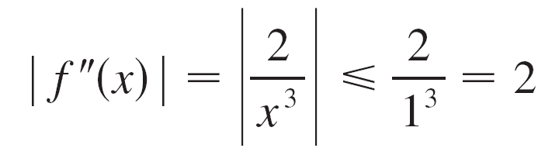

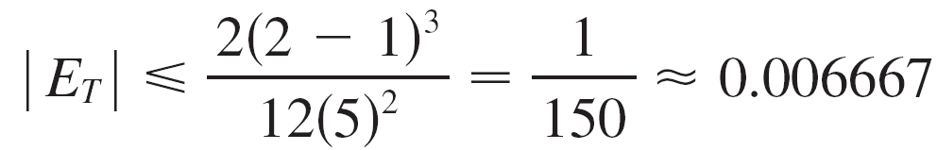
Approximate Integration
Let’s apply this error estimate to the Trapezoidal Rule approximation in Example 1.
If then and
Since we have so
Therefore, taking K = 2, a = 1, b = 2 and n = 5 in the error estimate , we see that

Slide 29



Example 2
How large should we take n in order to guarantee that the Trapezoidal and Midpoint Rule approximations for are accurate to within 0.0001?
SOLUTION:
We saw in the preceding calculation that for so we can take K = 2, a = 1, and b = 2 in .
Accuracy to within 0.0001 means that the size of the error should be less than 0.0001.

Slide 30
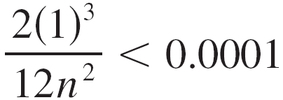
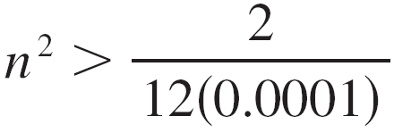
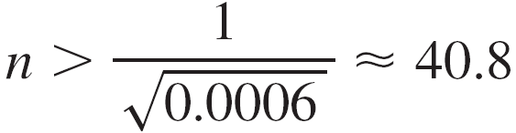
Example 2 – Solution
Therefore we choose n so that
Solving the inequality for n, we get
or
Thus n = 41 will ensure the desired accuracy.

Slide 31
Example 2 SOLUTION
It’s quite possible that a lower value for n would suffice.
However, 41 is the smallest value for which the error-bound formula can guarantee us accuracy to within 0.0001

Slide 32
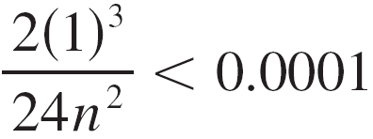
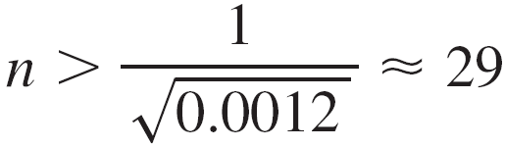
Example 2 – Solution
For the same accuracy with the Midpoint Rule we choose n so that
which gives

Slide 33
Example 3
Use the Midpoint Rule with n = 10 to approximate the integral
Give an upper bound for the error involved in this approximation.

Slide 34
Example 3(a) SOLUTION
As a = 0, b = 1, and n = 10, the Midpoint Rule gives:

Slide 35
Example 3(a) SOLUTION
Figure 6 The approximation.

Slide 36
Example 3(b) SOLUTION
As f(x) = e^{x2}, we have: f ’(x) = 2xe^{x2} and f ’’(x) = (2 + 4x²)e^{x2}
Also, since 0 ≤ x ≤ 1, we have x² ≤ 1.
Hence, 0 ≤ f’’(x) = (2 + 4x²) e^{x2} ≤ 6e

Slide 37
Example 3(b) SOLUTION
Taking K = 6e, a = 0, b = 1, and n = 10 in the error estimate (3), we see that an upper bound for the error is:

Slide 38
SIMPSON’S RULE
Another rule for approximate integration results from using parabolas instead of straight line segments to approximate a curve.
As before, we divide [a, b] into n subintervals of equal length h = ∆x = (b – a)/n.
However, this time, we assume n is an even number.

Slide 39
SIMPSON’S RULE
Then, on each consecutive pair of intervals, we approximate the curve y = f(x) ≥ 0 by a parabola, as shown in Figure 7.

Slide 40
SIMPSON’S RULE
If y_{i} = f(x_{i}), then P_{i}(x_{i}, y_{i}) is the point on the curve lying above x_{i}.
A typical parabola passes through three consecutive points: P_{i}, P_{i+1}, P_{i+2}

Slide 41
SIMPSON’S RULE
To simplify our calculations, we first consider the case where: x₀ = – h, x₁ = 0, x₂ = h
x₀ = – h, x₁ = 0, x₂ = h

Slide 42
SIMPSON’S RULE
We know that the equation of the parabola through P₀, P₁, and P₂ is of the form y = Ax² + Bx + C

Slide 43
SIMPSON’S RULE
Therefore, the area under the parabola from x = – h to x = h is:

Slide 44
SIMPSON’S RULE
However, as the parabola passes through P₀(– h, y₀), P₁(0, y₁), and P₂(h, y₂), we have: y₀ = A(– h)² + B(– h) + C = Ah² – Bh + C y₁ = C y₂ = Ah² + Bh + C

Slide 45
SIMPSON’S RULE
Therefore, y₀ + 4y₁ + y₂ = 2Ah² + 6C
So, we can rewrite the area under the parabola as:

Slide 46
SIMPSON’S RULE
Now, by shifting this parabola horizontally, we do not change the area under it.

Slide 47
SIMPSON’S RULE
This means that the area under the parabola through P₀, P₁, and P₂ from x = x₀ to x = x₂ is still:

Slide 48
SIMPSON’S RULE
Similarly, the area under the parabola through P₂, P₃, and P₄ from x = x₂ to x = x₄ is:

Slide 49
SIMPSON’S RULE
Thus, if we compute the areas under all the parabolas and add the results, we get:

Slide 50
SIMPSON’S RULE
Though we have derived this approximation for the case in which f(x) ≥ 0, it is a reasonable approximation for any continuous function f .
Note the pattern of coefficients: 1, 4, 2, 4, 2, 4, 2, . . . , 4, 2, 4, 1
This is called Simpson’s Rule—after the English the English mathematician Thomas Simpson (1710–1761).

Slide 51
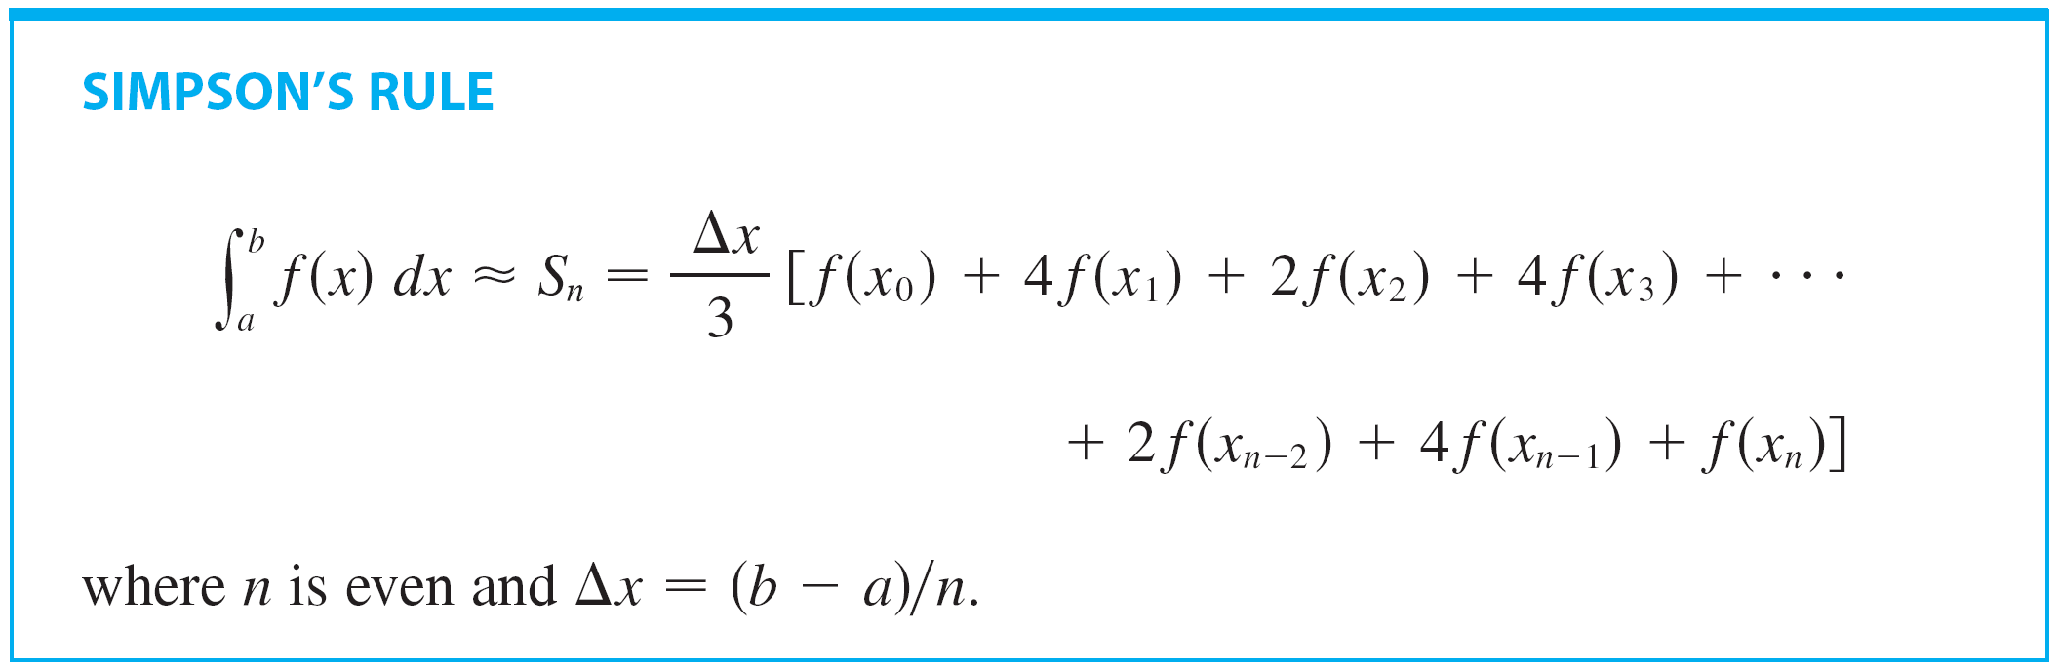
Simpson’s Rule
Following is the another approximation, called Simpson’s Rule, note the pattern of coefficients: 1, 4, 2, 4, 2,..., 4, 2, 4, 1

Slide 52


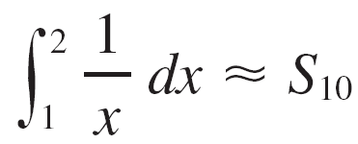
Example 4
Use Simpson’s Rule with n = 10 to approximate
SOLUTION:
Putting f (x) = 1/x, n = 10, and in Simpson’s Rule, we obtain

Slide 53

Example4 – Solution

Slide 54

Simpson’s Rule
Notice that, in Example 4, Simpson’s Rule gives us a much better approximation (S₁₀ ≈ 0.693150) to the true value of the integral (In 2 ≈ 0.693147. . .) than does the Trapezoidal Rule (T₁₀ ≈ 0.693771) or the Midpoint Rule (M₁₀ ≈ 0.692835).
It turns out that the approximations in Simpson’s Rule are weighted averages of those in the Trapezoidal and Midpoint Rules:
(We have known that E_{T} and E_{M} usually have opposite signs and |E_{M}| is about half the size of |E_{T}|.)

Slide 55
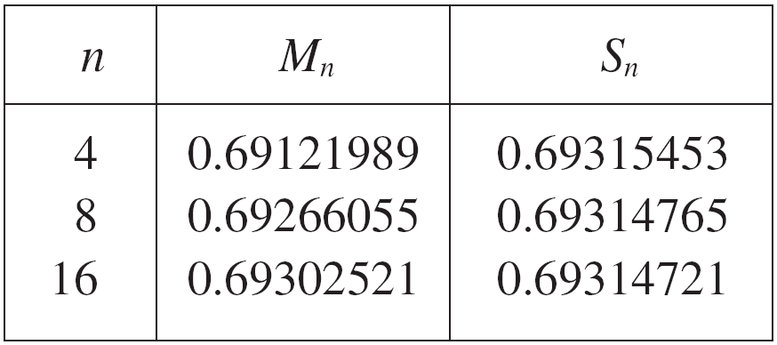

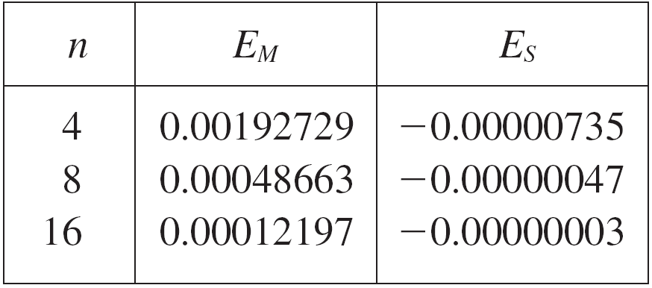
Simpson’s Rule
The table in the right shows how Simpson’s Rule compares with the Midpoint Rule for the integral
whose value is about
0.69314718.
The second table shows how the error E_{S} in Simpson’s Rule decreases by a factor of about 16 when n is doubled.

Slide 56
Example 5
The figure shows data traffic on the link from the U.S. to SWITCH, the Swiss academic and research network, on February 10, 1998.
D(t) is the data throughput, measured in megabits per second (Mb/s).

Slide 57
Example 5 SOLUTION
Use Simpson’s Rule to estimate the total amount of data transmitted on the link up to noon on that day.

Slide 58
Example 5 SOLUTION
Since we want the units to be consistent and D(t) is measured in Mb/s, we convert the units for t from hours to seconds.

Slide 59
Example 5 SOLUTION
If we let A(t) be the amount of data (in Mb) transmitted by time t, where t is measured in seconds, then A’(t) = D(t).
So, by the Net Change Theorem (Section 5.4), the total amount of data transmitted by noon (when t = 12 × 60² = 43,200) is:

Slide 60
Example 5 SOLUTION
We estimate the values of D(t) at hourly intervals from the graph and compile them here.

Slide 61
Example 5 SOLUTION
We estimate the values of D(t) at hourly intervals from the graph and compile them.
Then, we use Simpson’s Rule with n = 12 and ∆t = 3600 to estimate the integral.
The total amount of data transmitted up to noon is 144,000 Mbs, or 144 gigabits.
p. 539

Slide 62
SIMPSON’S RULE
In Exercise 24 you are asked to demonstrate, in a particular case, that the error in Simpson’s Rule decreases by a factor of about 16 when n is doubled.
That is consistent with the appearance of n⁴ in the denominator of the following error estimate for Simpson’s Rule.
It is similar to the estimates given in (3) for the Trapezoidal and Midpoint Rules.
However, it uses the fourth derivative of f.

Slide 63
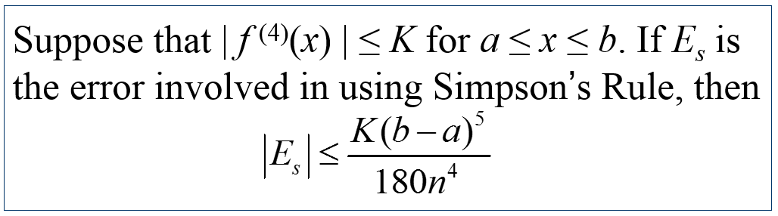
ERROR BOUND FOR SIMPSON’S RULE

Slide 64




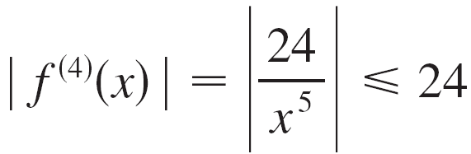
Example 6
How large should we take n in order to guarantee that the Simpson’s Rule approximation for is accurate to within 0.0001?
SOLUTION:
If f (x) = 1/x, then Since we have and so

Slide 65

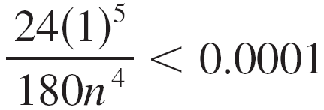
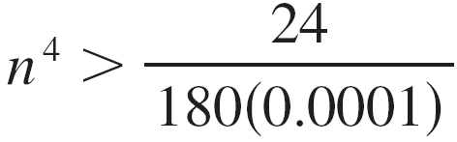
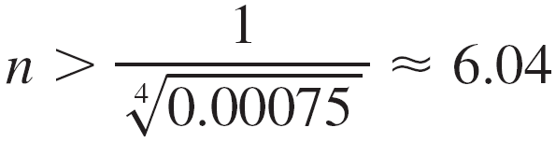
Example6 – Solution
Therefore we can take K = 24 in . Thus for an error less than 0.0001 we should choose n so that
This gives
or

Slide 66
Example6 – Solution
Therefore n = 8 (n must be even) gives the desired accuracy.
Compare this with Example 2, where we obtained n = 41 for the Trapezoidal Rule and n = 29 for the Midpoint Rule.

Slide 67
Example 7
Use Simpson’s Rule with n = 10 to approximate the integral .
Estimate the error involved in this approximation.

Slide 68
Example 7(a) SOLUTION
If n =10, then ∆x = 0.1 and the rule gives:

Slide 69
Example 7(b) SOLUTION
The fourth derivative of f(x) = e^{x2} is: f ⁽⁴⁾(x) = (12 + 48x² + 16x⁴)e^{x2}
So, since 0 ≤ x ≤ 1, we have: 0 ≤ f ⁽⁴⁾(x) ≤ (12 + 48 +16)e¹ = 76e

Slide 70
Example 7(b) SOLUTION
Putting K = 76e, a = 0, b = 1, and n = 10 in (4), we see that the error is at most:
Compare this with Example 3(b).
Thus, correct to three decimal places, we have:

